Slide 1

Data Lake

Slide 2
Audience
No experience needed for Azure Databricks , we will start from Scratch
An Azure account for hands-on practical
Basic knowledge on Python and SQL
Basic knowledge on Azure Cloud Environment

Slide 3
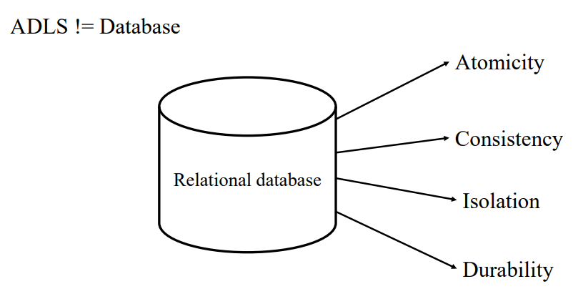
Drawbacks of ADLS

Slide 4
Drawbacks of ADLS
No ACID properties
Job failures lead to inconsistent data
Simultaneous writes on same folder brings incorrect results
No schema enforcement
No support for updates
No support for versioning
Data quality issues

Slide 5
What is delta lake
Open-source storage framework that brings reliability to data lakes
Brings transaction capabilities to data lakes
Runs on top of your existing datalake and supports parquet
Enables Lakehouse architecture

Slide 6
Lake house architecture

Slide 7
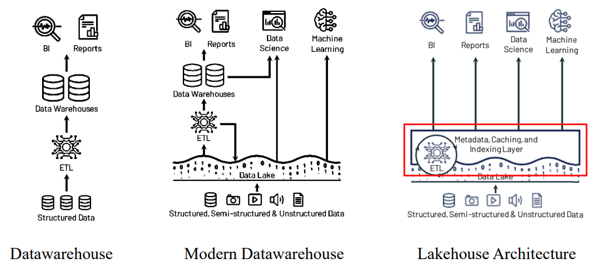
Use data lake

Slide 8
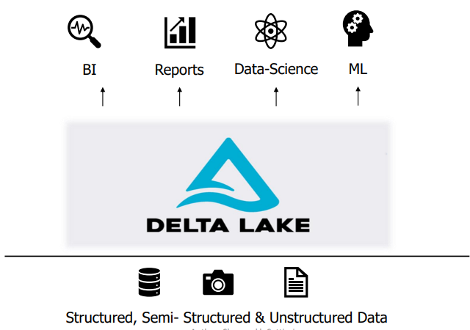
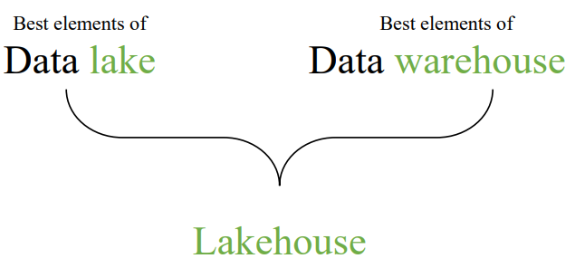
Lake house architecture

Slide 9
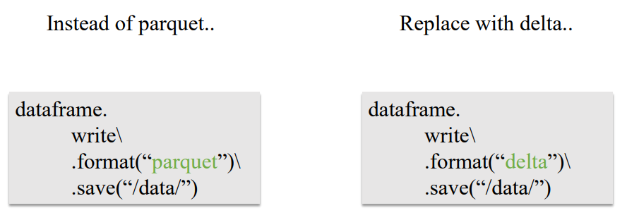
How to create a datalake

Slide 10
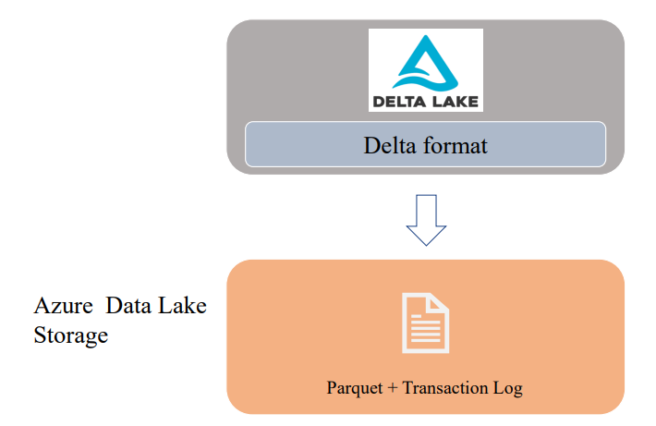

Slide 11
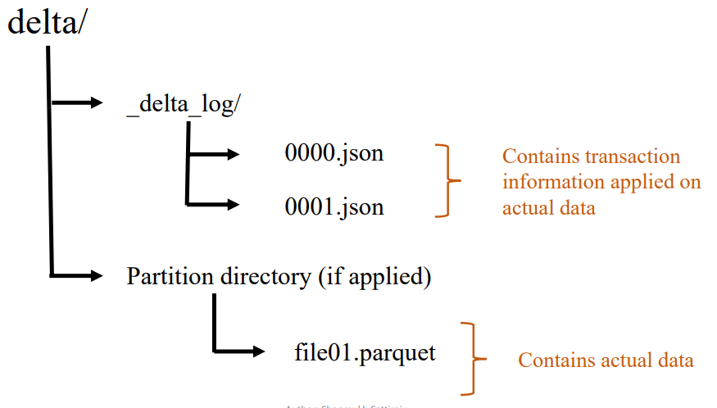

Slide 12
Understanding Transaction log file (Delta Log)
Contains records of every transaction performed on the delta table
Files under _delta_log will be stored in JSON format
Single source of truth

Slide 13
Transaction log contents
JSON File = result of set of actions
metadata – Table’s name, schema, partitioning ,etc
Add – info of added file (with optional statistics)
Remove – info of removed file
Set Transaction – contains record of transaction id
Change protocol – Contains the version that is used
Commit info – Contains what operation was performed on this

Slide 14
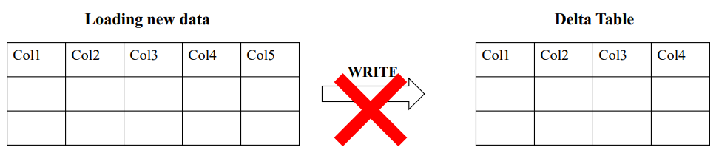
Schema enforcement

Slide 15
How does schema enforcement works?
Delta lake uses Schema validation on “writes” .
Schema Enforcement Rules:
Cannot contain any additional columns that are not present in the target table's schema
Cannot have column data types that differ from the column data types in the target table.

Slide 16
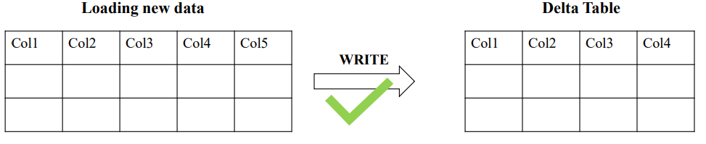
Schema Evolution

Slide 17
Audit Data Changes & Time Travel
Delta automatically versions every operation that you perform
You can time travel to historical versions
This versioning makes it easy to audit data changes, roll back data in case of accidental bad writes or deletes, and reproduce experiments and reports

Slide 18
Vacuum in Delta lake
Vacuum helps to remove parquet files which are not in latest state in transaction log
It will skip the files that are starting with _ (underscore) that includes _delta_log
It deletes the files that are older then retention threshold
Default retention threshold in 7 days
If you run VACUUM on a Delta table, you lose the ability to time travel back to a version older than the specified data retention period

Slide 19
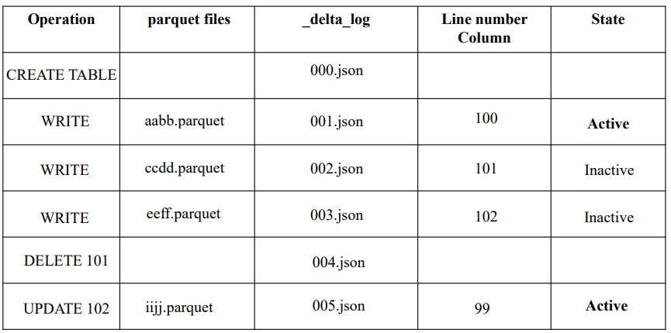
Optimize in Delta lake

Slide 20
UPSERT (Merge) in delta lake
We can UPSERT (UPDATE + INSERT) data using MERGE command.
If any matching rows found, it will update them
If no matching rows found, this will insert that as new row
MERGE INTO <destination_table>USING <source_table)
ON <dest>.Col2 =<source> .Col2
WHEN MATCHED THEN UPDATE SET <dest>.Col1 = <source>.Col1, <dest>.Col2 = <source>.Col2
WHEN NOT MATCHED THEN INSERT VALUES(Source.Col1, Source.Col2)

Slide 21
Accessing DataLake

Slide 22
Accessing delta lake
There are number of ways DataBricks can authenticate to Azure Datalake Storage gen2
Authentication
Session scoped Authentication
Storage access key
Shared access signature (SAS Token)
Cluster Scoped Authentication
Service Principal
Azure active directory (AAD passthrough)
Unity Catelog

Slide 23
Lock and key

Slide 24
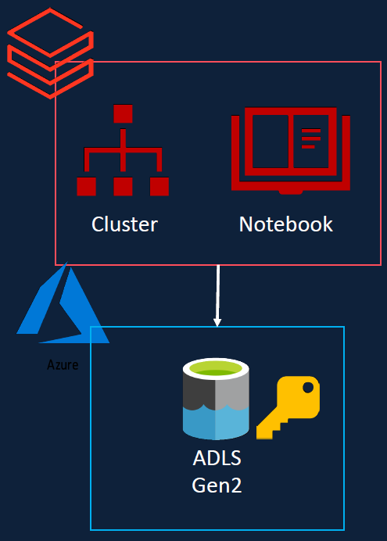
Accessing Azure Data Lake
Storage Access Keys: each storage account is having access key to access storage account.
Shared access signature (SAS token): SAS Access managed at more granular level than the access key.
Service principal: Give the required access to the data lake to service principal and use that credentials to access storage account.

Slide 25
Types of Scope
Session scoped authentication: Limited till the session is active or until notebook is attached to the cluster
Cluster scoped authentication: Authentication will happen when the cluster starts until the cluster has been terminated.

Slide 26
More authentication types:
AAD (Azure Active directory) passthrough authentication: Whenever user runs the notebook, cluster will users active directory credential and look for the roles user has been assigned to the data lake storage using IIM or identity and access management. AAD passthrough is available only on premium workspace.
Unity Catalog: Administrator define the access permission for the user using the Unity Catalog. When user is trying to access the cluster will check for the user access in the unity catalog. It has the required permission then allow the user to access storage account otherwise no permission
Both of the above types are available on the premium workspaces.

Slide 27
Creating Azure Data Lake Storage Gen2
Pass the proper name and resource group
Create storage account using the service. Tick on enable hierarchical namespace from advance tab.
Enable soft delete keeps the deleted containers for 7 days by default.
Rest of the data are same and create the resource group.
Once the resource group is created then go to the resource. On the left side following access types are available
Access keys , SAS, Access Control(IMA)

Slide 28
Create containers
Create four containers
Bronze
Silver
Gold
Demo

Slide 29
Desktop tool for storage
Azure storage explorer: Easy to handle data when it is large process and huge data storage.
Azure container not allowed to upload folders where as same can be done through Azure storage explorer.
How to download Azure storage Explorer..?
Azure Storage Explorer – cloud storage management | Microsoft Azure

Slide 30
Access Azure Data Lake Storage Gen2 using Access Keys
Each storage account comes with 2 keys
Access key gives full access to the account
Keys can be rotated (regenerated)
In order to access data from databricks we need to provide one of the access key to azure databricks. We can do this by assigning one of the key to spark configuration.

Slide 31

Spark configuration
Configuration has two parts one is key and followed by end point of storage account.

Slide 32
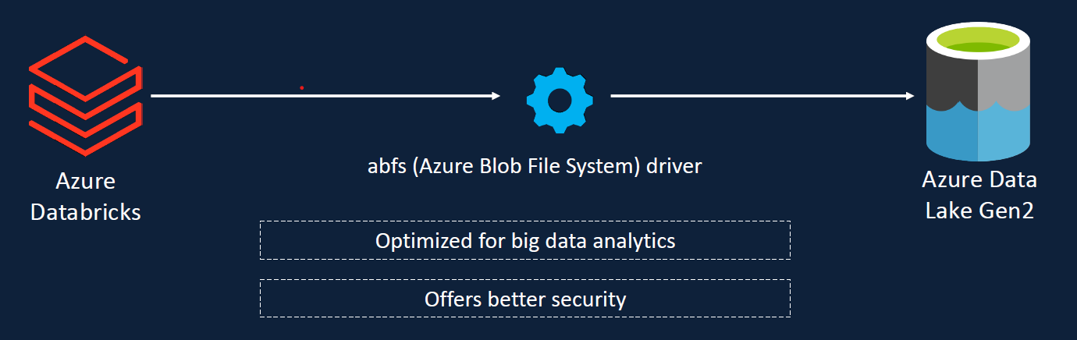
Access Key – abfs driver
Azure Blob file system driver to access data stored
It’s a new driver for apache Hadoop, and it’s optimized for big data analytics work load and offers better security
The Azure Blob Filesystem driver for Azure Data Lake Storage Gen2 - Azure Storage | Microsoft Learn

Slide 33
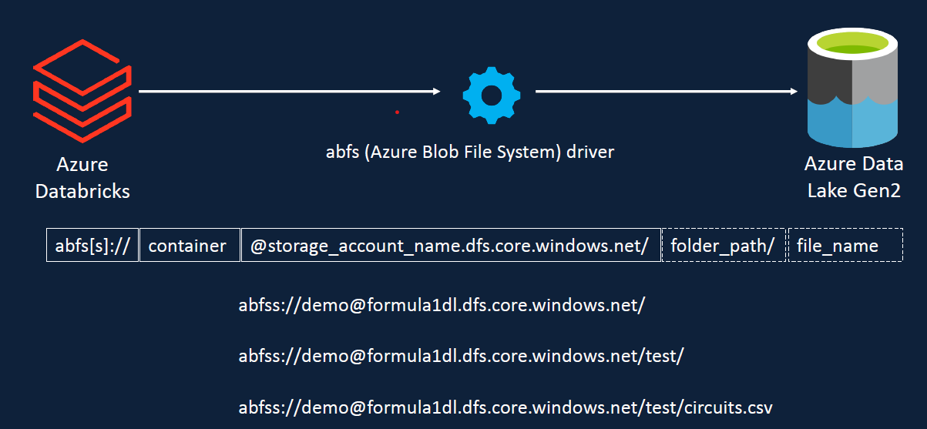

Slide 34
Components
Lets look at the URL scheme to access files in ADLS Gen 2 using the ABFS drivers. It’s slightly different from HTTP protocol.
Components of ABFS URL:
It’s starts with abfs[s] (data will be encrypted and provide additional security)
Then name of container and storage account end point (dfs endpoint)
Next component is folder path and file name

Slide 35
Steps to perform
Go to databricks workspace
Create a new folder FNAME outside of the user folder . Create a sub folder as set_up which will be containing all environmental setup related files.
Create a new notebook “access_adls_using_access_key.ipynb” in Cluster db_course_cluster. Start the cluster before using it.
Folder path: D:\Azure\AZURE_Other_servises\Azure_databricks\Formula1-Project-Solutions\Formula1-Project-Solutions\Section-06\set-up

Slide 36
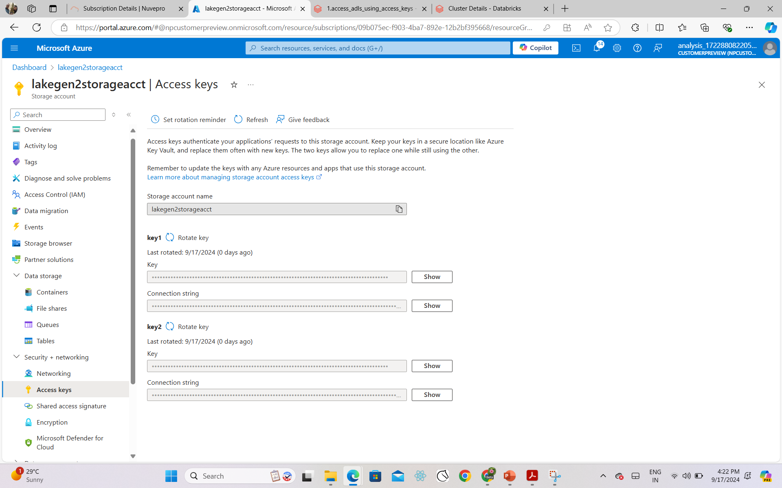
How to get acess key

Slide 37
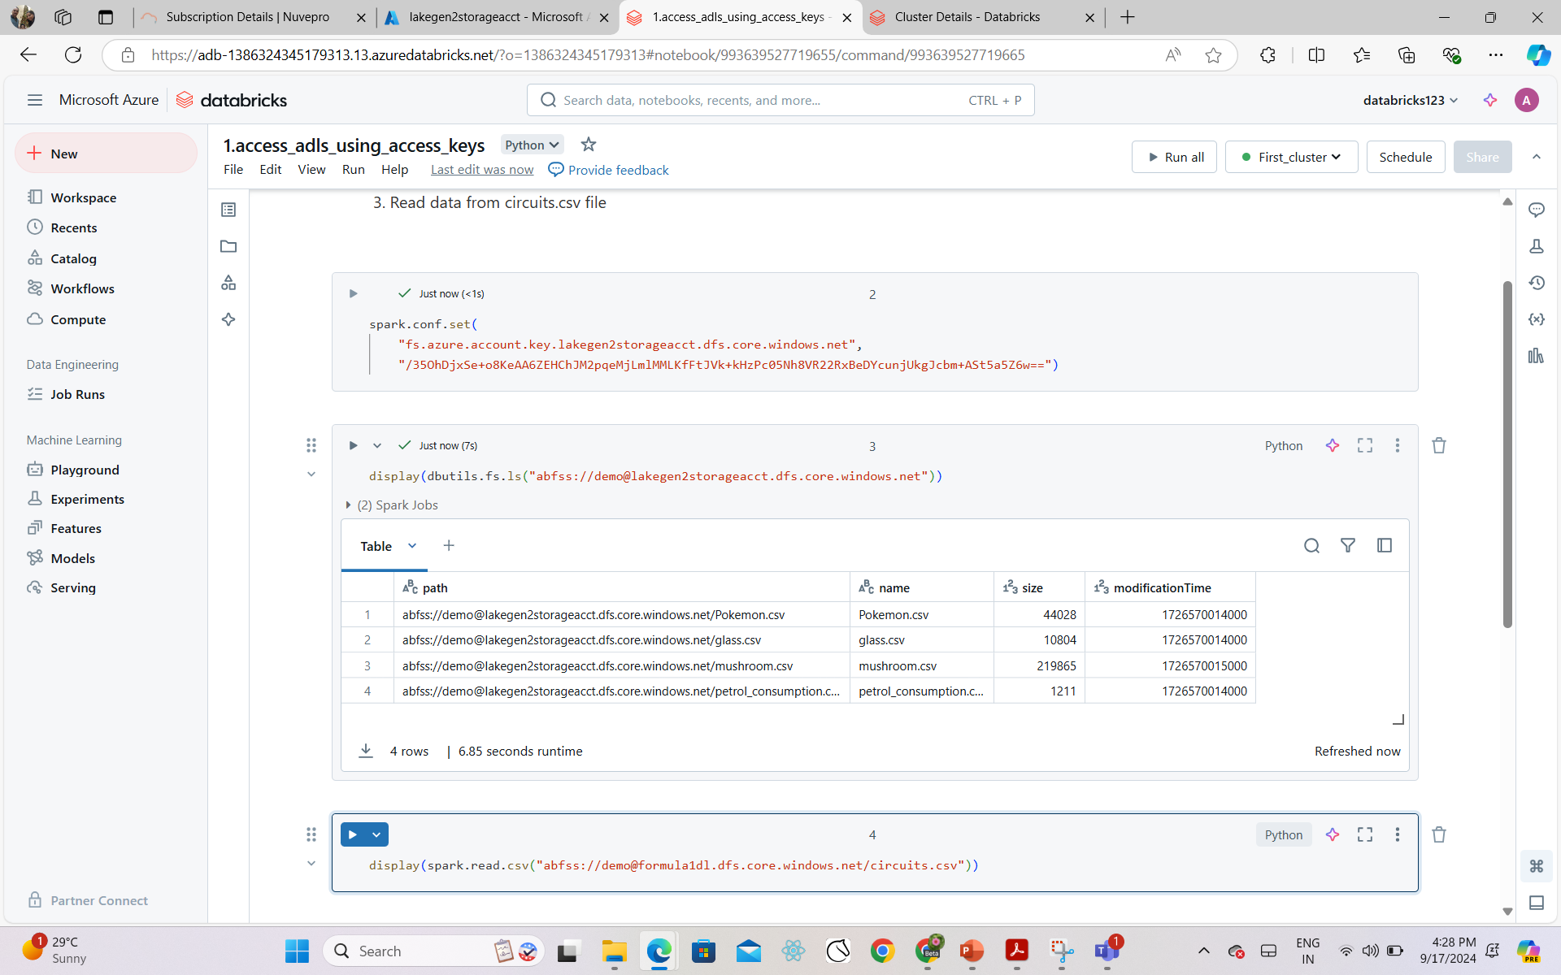
configuration

Slide 38
Drawback
Problem with the ABFS is , it will give the full access to the end test. This is not always required.
Generally we need to restrict the access and provide only limited access to the users.
E.g provide only read access to users and also limited period of time. That’s where SAS token (Shared access signature) came into the picture.

Slide 39
Shared access Signature (SAS token)
Unlike access key SAS key is used to control access on more granular level
We can restrict access to specific resource type or services e.g. allow to access only block
Specific permission e.g. allow read only access to a container and restricting user for writing or deleting the blobs
Restrict the specific time period
Limit access to specific IP address.
This type is recommended access pattern for external client
Reference : Grant limited access to data with shared access signatures (SAS) - Azure Storage | Microsoft Learn

Slide 40
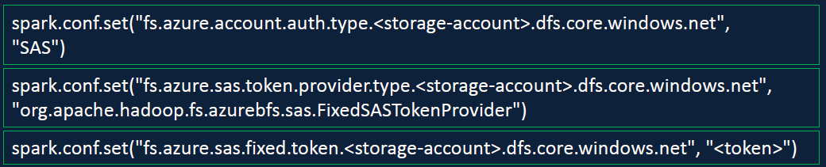
Practical
Add Shared access Signature to Azure Data Bricks using the token

Slide 41
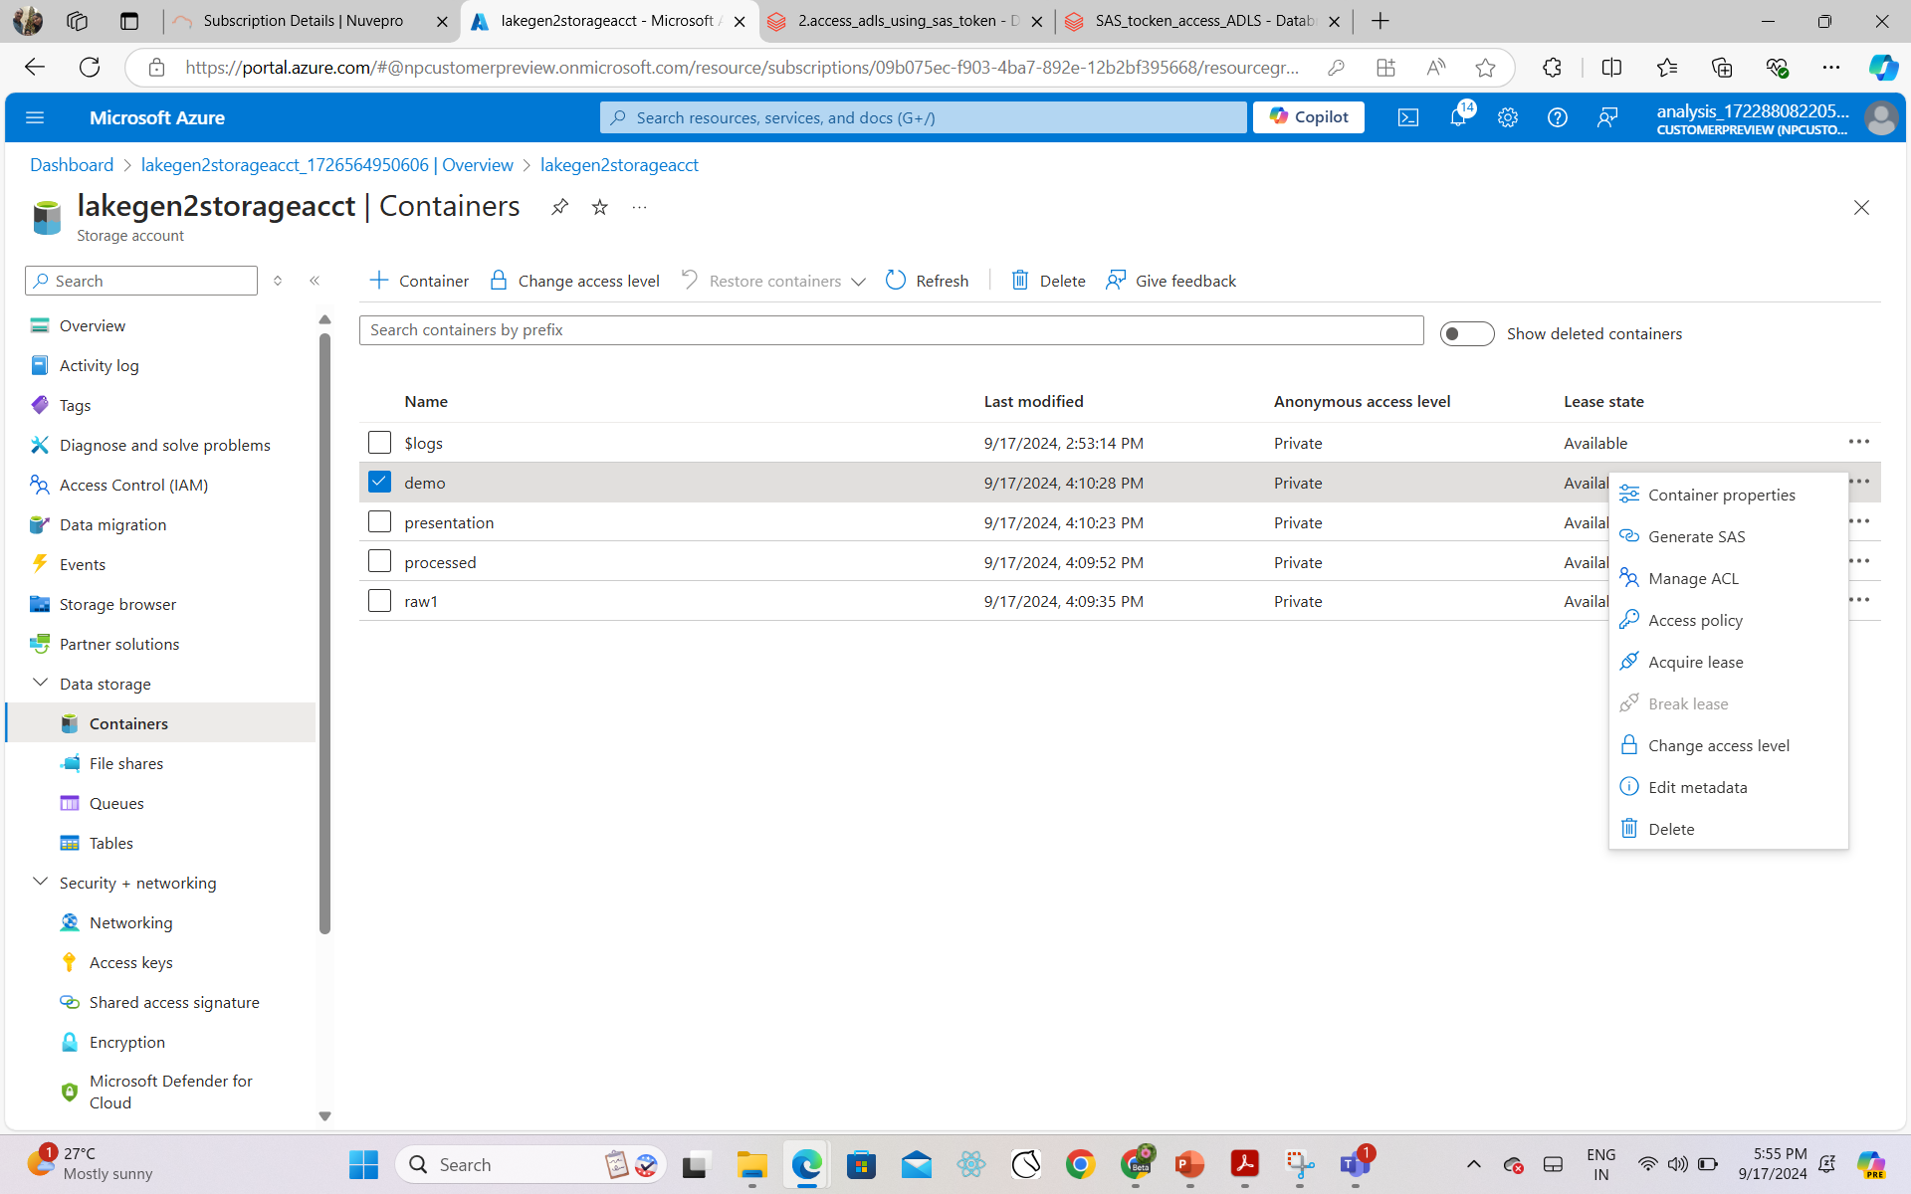
Practical

Slide 42
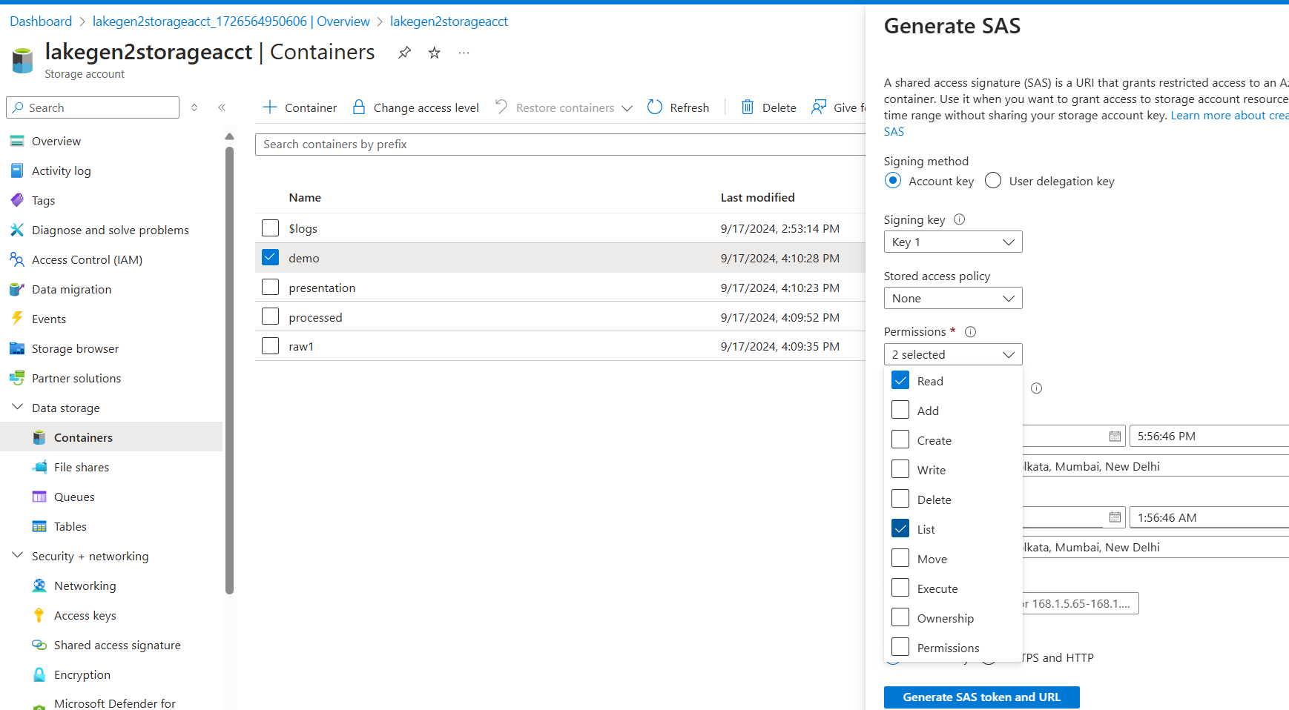
Defining Permissions

Slide 43
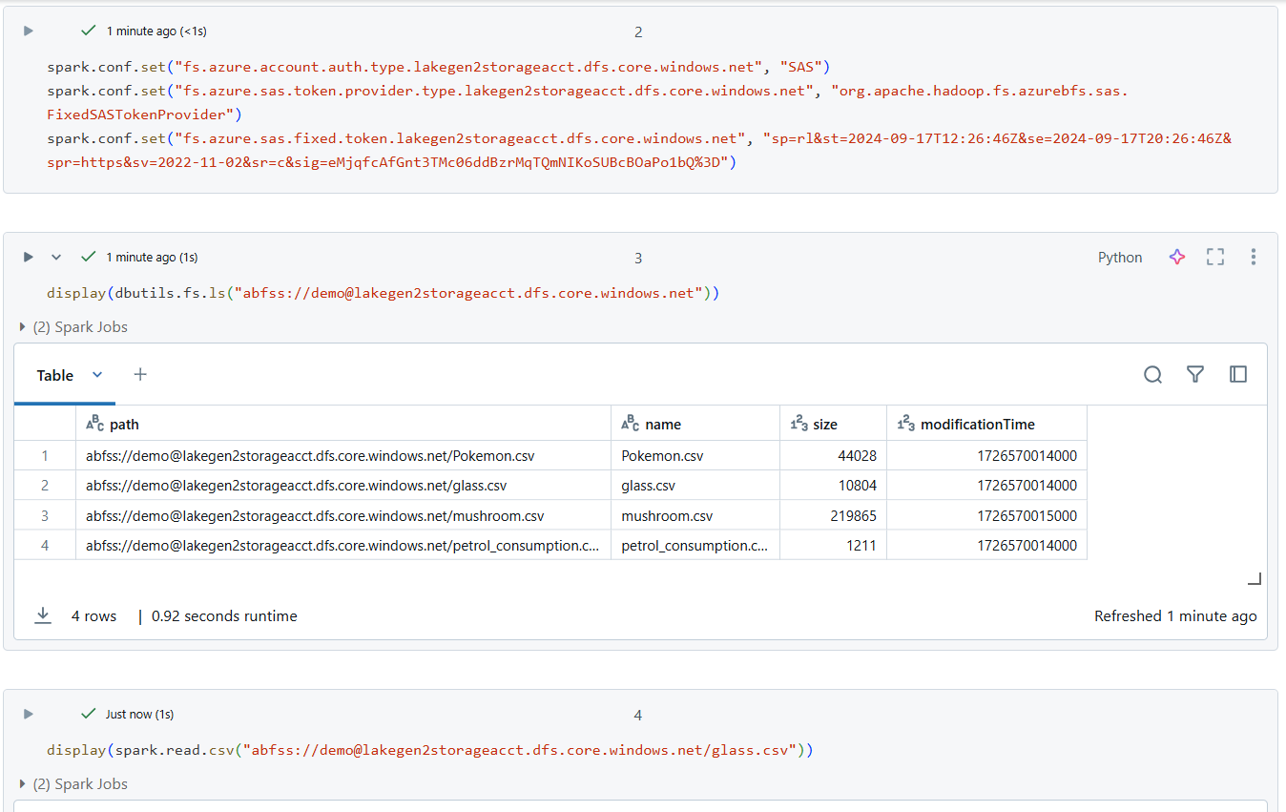
Setting link to configue

Slide 44
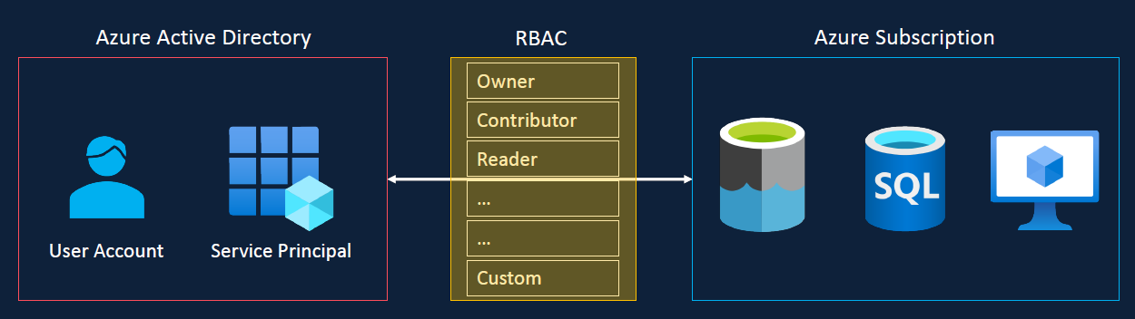
Service principal
For better architecture each application will have it’s own service principal and service principal is just assigned required permission on the resources.
All is better audited and monitored. So this provides better security and monitoring.
Role based access control(RBAC)

Slide 45
Accessing Azure Data lake using Service principal
Service principal are same as the user accounts/credentials
It can be resister in azure active directory and assign permission required to access resources in the azure subscription via role based access control or RBAC
Azure makes the number of standard roles available and you can also make the custom roles.
Service principals are the recommended methods to be used in automated tools such as Databricks jobs and CICD Pipelines. This is because they provide better security and traceability.

Slide 46
Steps:
Register Azure AD (active directory) application/Service principal
Currently renamed as Microsoft Entra ID
Manage-> App registration->new registration -> trial_1
Generate a secret/ password for the application: configure the databricks to access storage account by service principal
Set spark config with App/Client Id, directory/Tenant ID & Secret
Assign role Storage Blob Data contributor to the Data Lake.
Link: Connect to Azure Data Lake Storage Gen2 and Blob Storage - Azure Databricks | Microsoft Learn

Slide 47
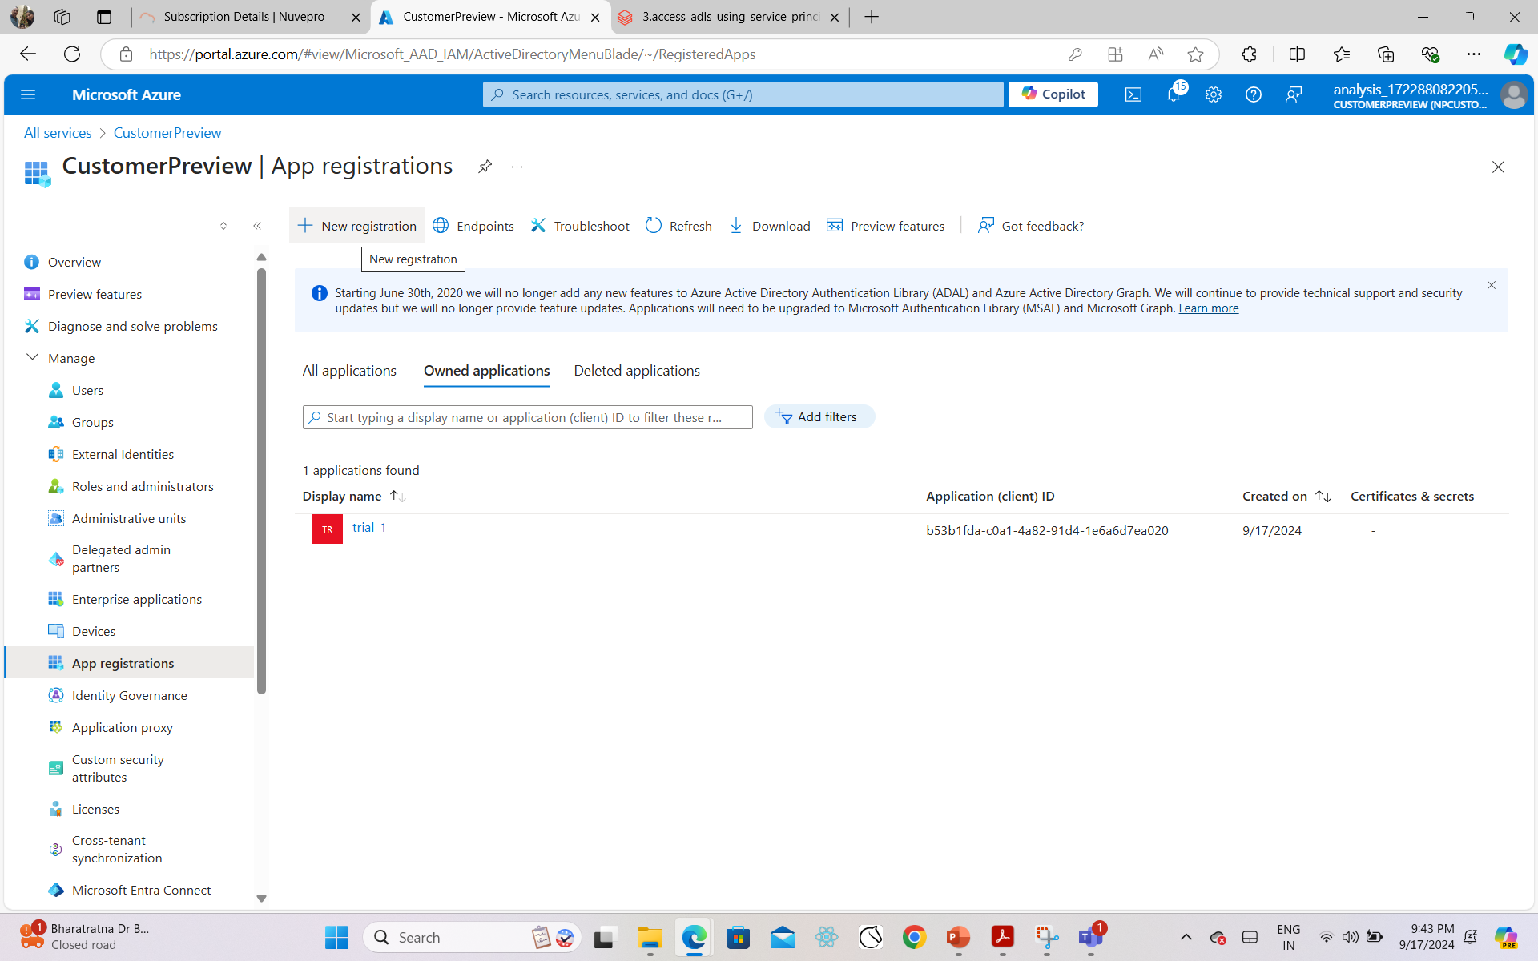
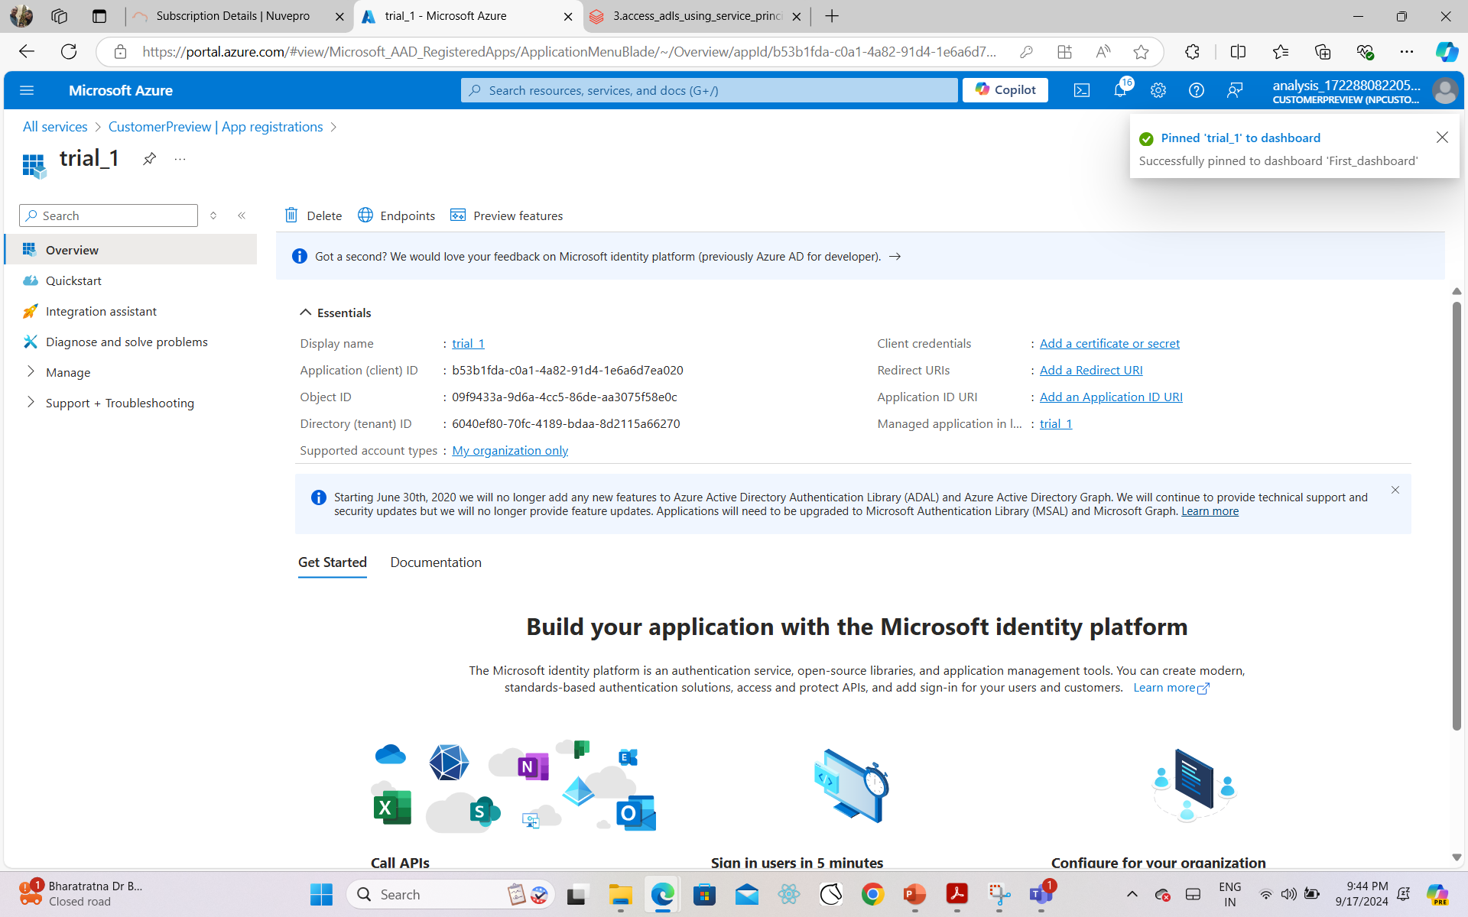
Practical: creating service principal

Slide 48
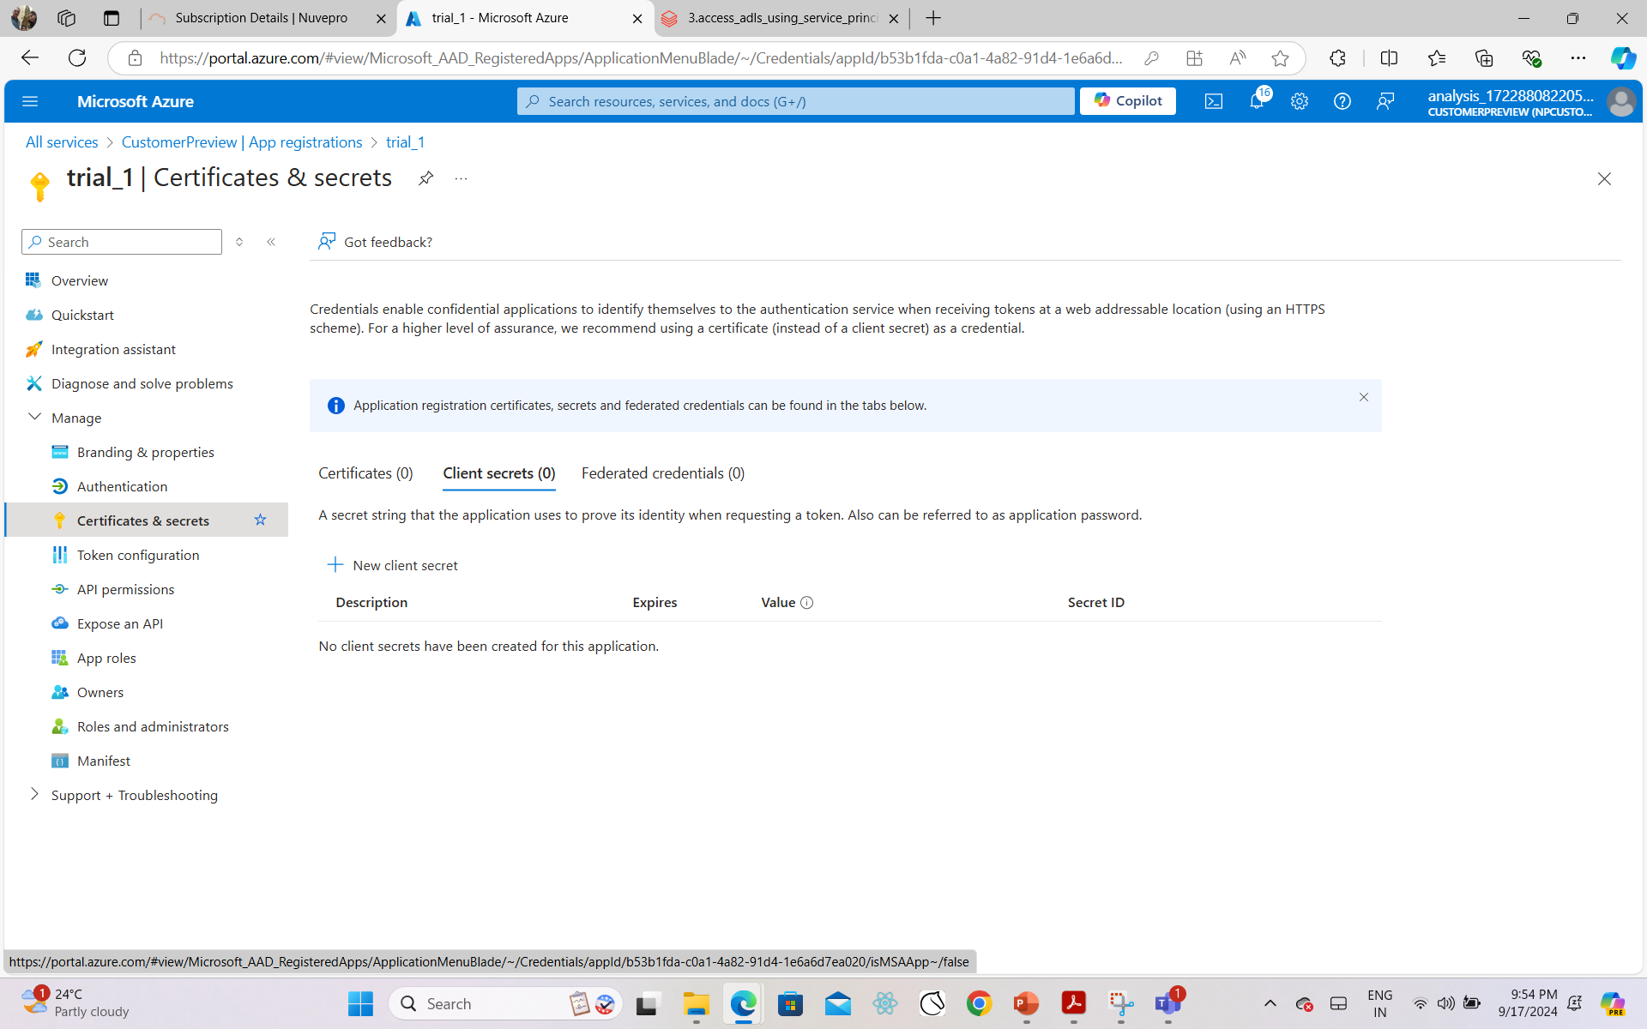
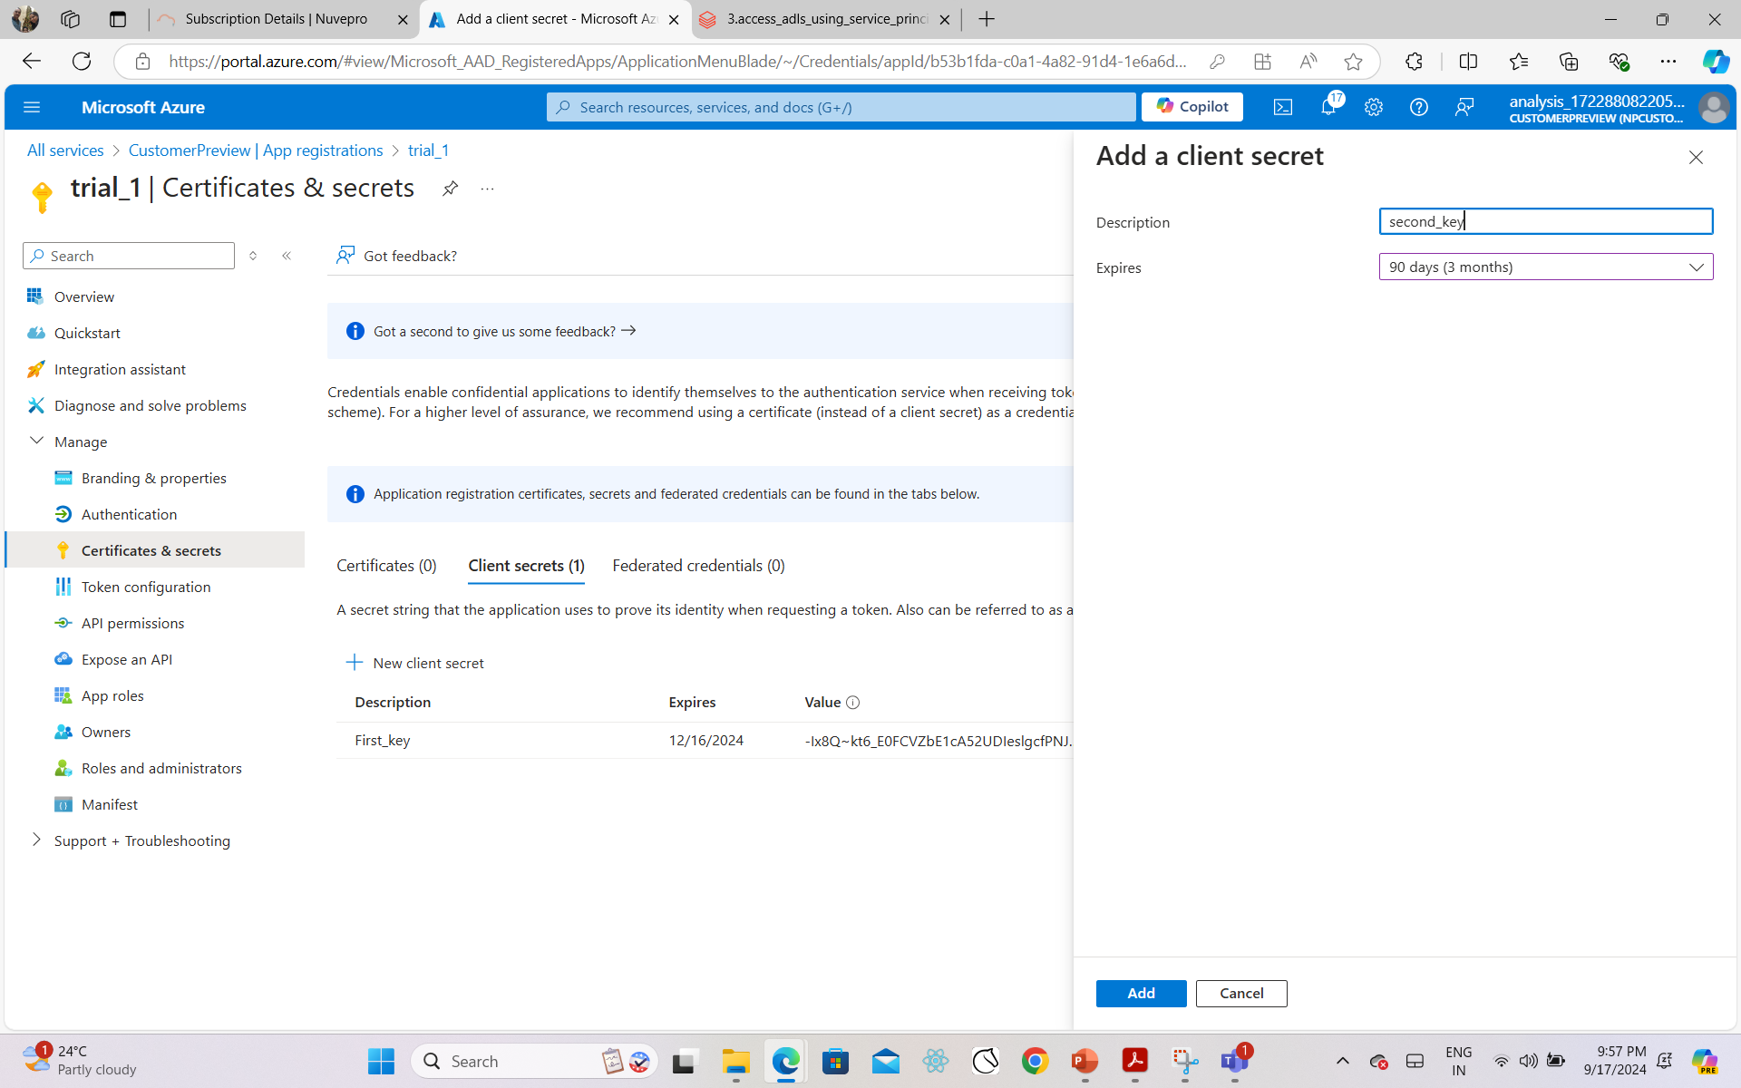
Practical

Slide 49
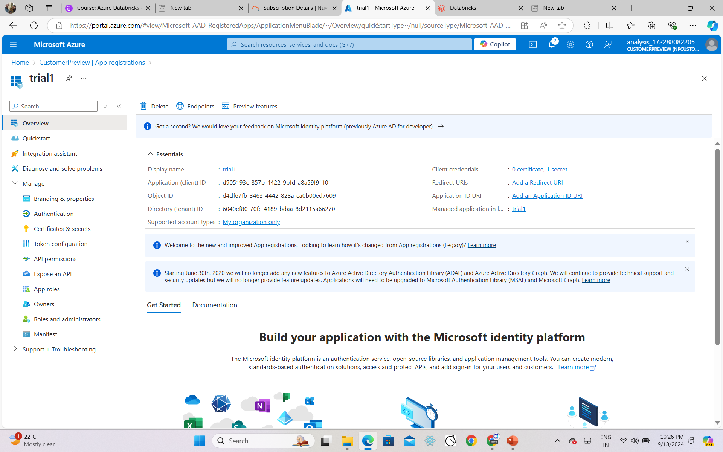
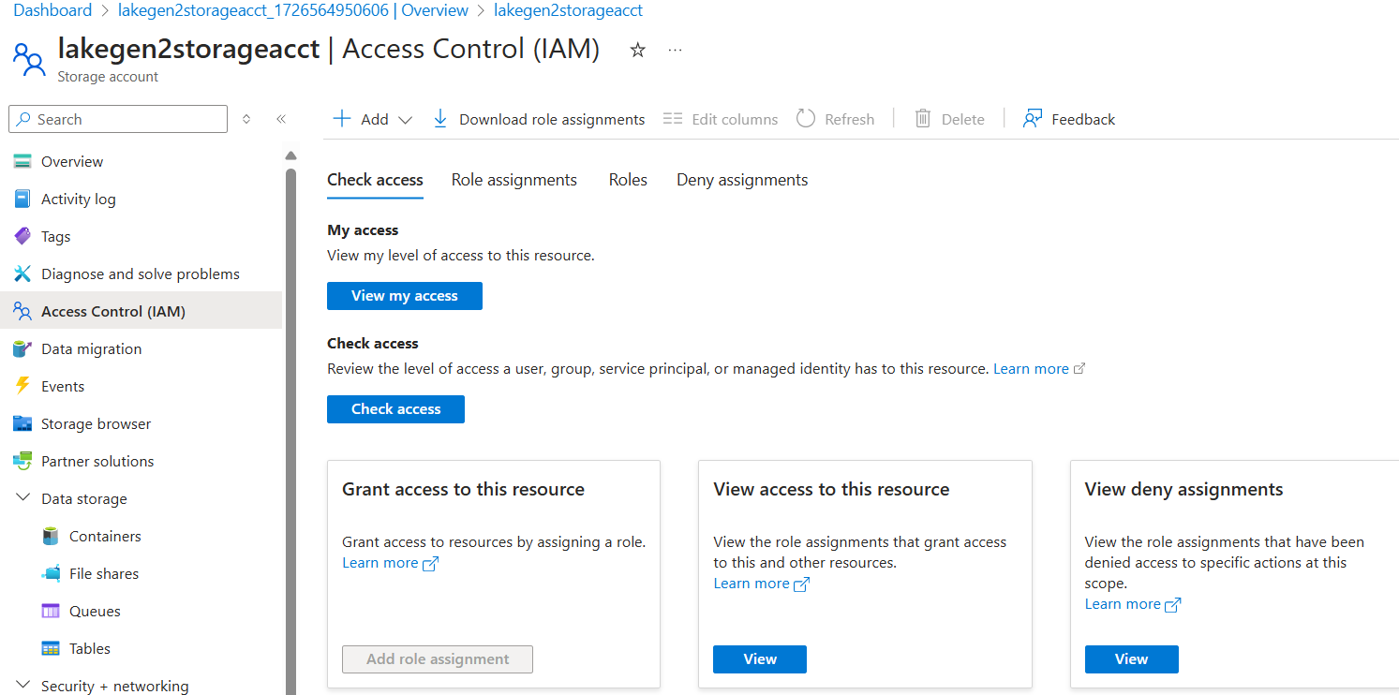
Assign role Storage blob contributor to the data lake

Slide 50
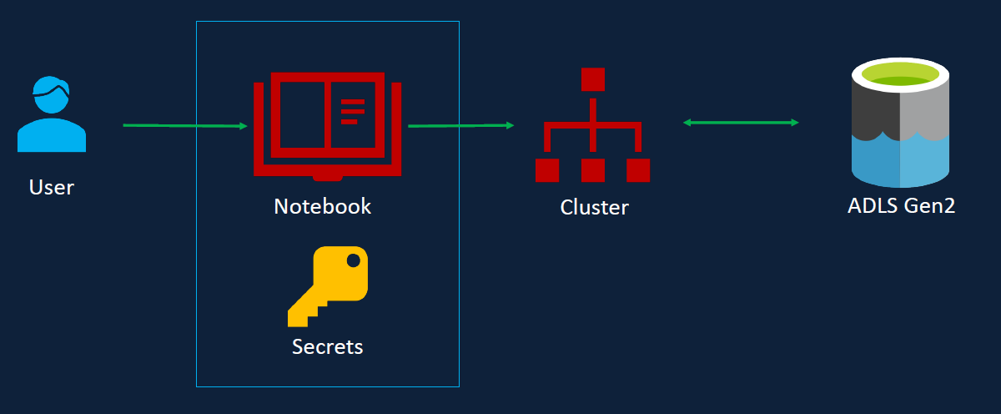
Session scoped Authentication
User using notebook having the key and able to access the ADLS using cluster
This is session scoped Authentication
This is only valid within the session
Once notebook is detached from cluster we will have to reauthenticate the notebook again to access the storage account

Slide 51
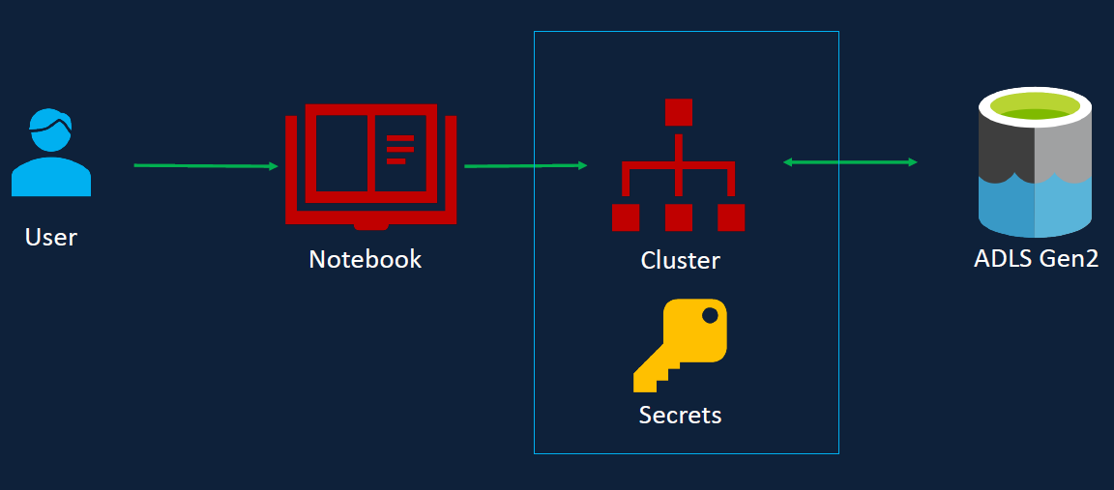
Cluster scoped Authentication
Instead of accessing ADLS separately, we can authenticate based on cluster. We can do that by specifying the spark configuration parameter and corresponding secrete values within the cluster configuration.
So when cluster is created it already has the spark configuration secrete values within the cluster.

Slide 52
Cluster scoped Authentication
During the cluster creation, it already has the spark configuration set with the right secret values.
During the cluster creation, the authentication with the data lake will be complete, i.e. Spark configuration are executed.
Drawback: Every notebook run on this cluster has the access to Data lake.
So this cluster could not be used for other purposes, where some of users should have limited access to the data or no access to the data at all.
Effectively by defining the credentials in the cluster, we are making the cluster specific for one permission group, in which all users require the same level of access.

Slide 53
Cluster scoped Authentication
Cluster assignment may not be used in large project. E.g. if the data Engineers want permission to certain storage accounts, but analysts should not have, you need to create two clusters for the specific purposes and they can not share one cluster.
Because of this it is not a widely approach in the industry.
Let’s move to the practical

Slide 54
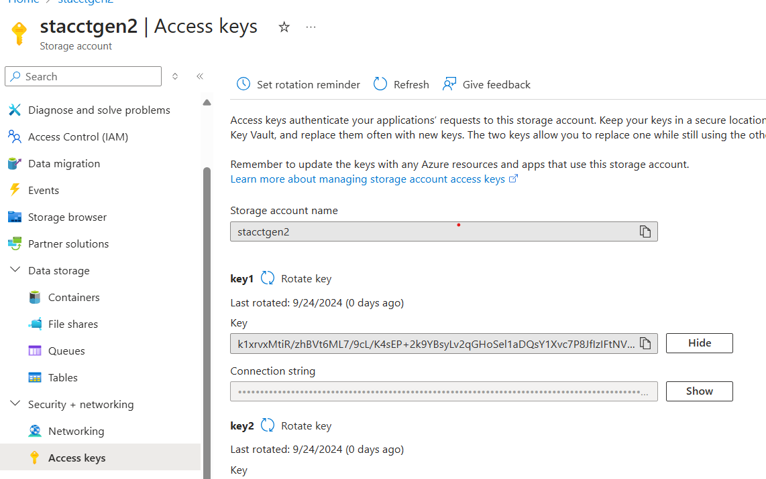
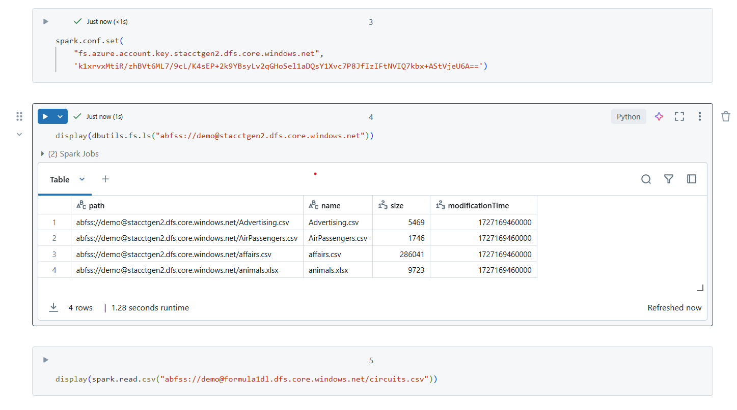
Step-1

Slide 55
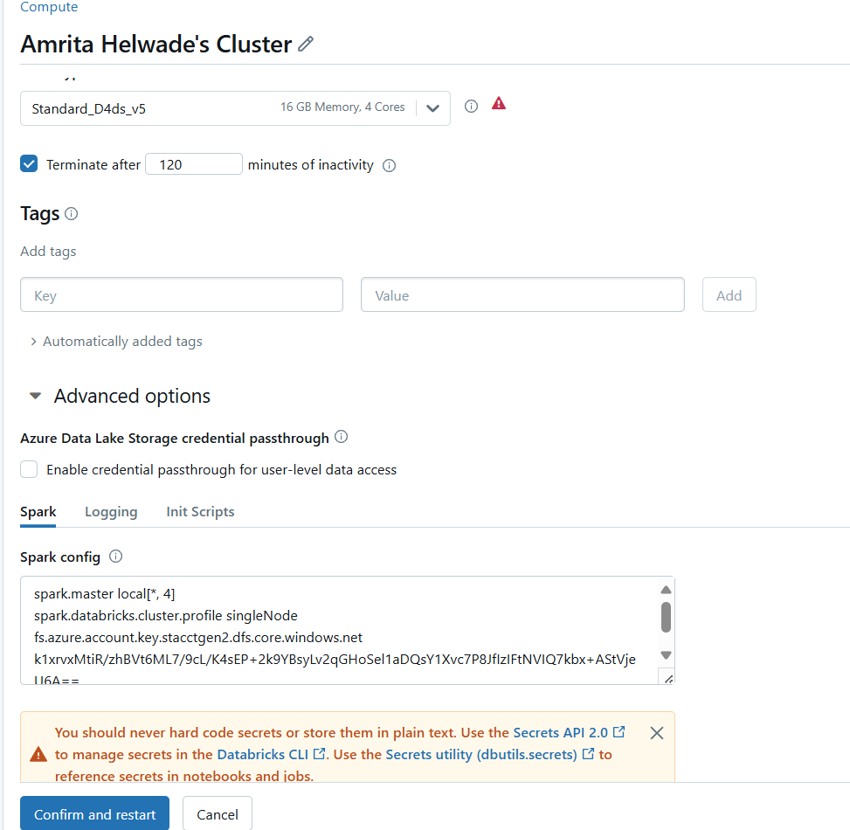
step2
Add the same to advance option to access the data
Then remove cell from notebook having values for spark.set.config

Slide 56
AAD Credential Passthrough
Till this point, we have been using access keys, SAS tokens and service principals to access the data.
They all give same level of access to every user as long as they have the secretes and access to the same clusters.
This is probably not what you want in certain scenarios. We might want to restrict access to users based on what they can see via the active directory account, this is called as AAD or Azure Active Directory Credential Pass-through Authentication.
Effectively, Databricks will pass the users, Azure Active Directory credentials to the ADL storage account to authenticate.

Slide 57
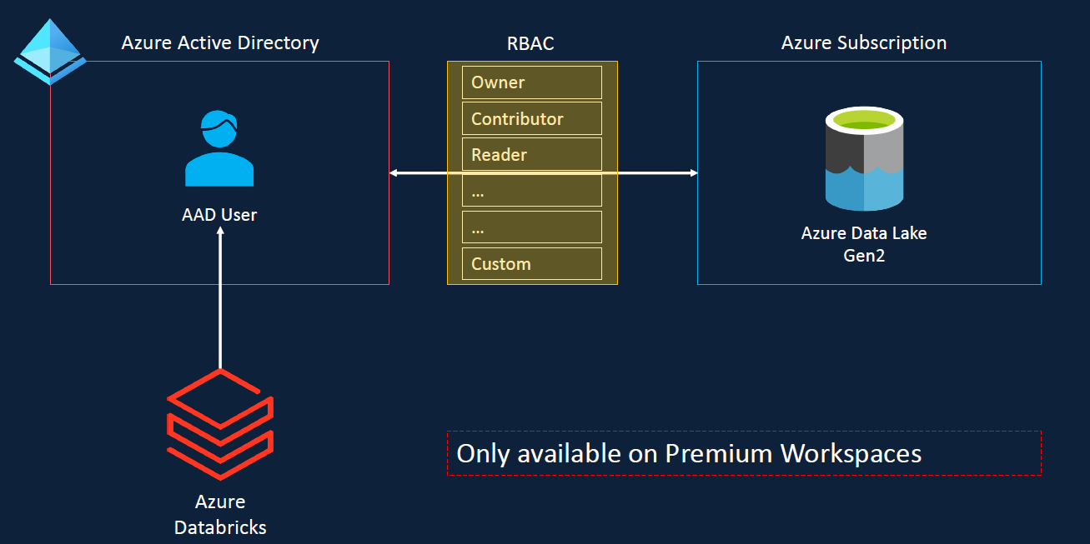
Azure Active Directory

Slide 58
AAD Credentials
If the specific user has the required role assigned in RBAC for the storage account, they will be able to access a storage account otherwise, they won’t be able to access the storage account
This is useful in scenario such as Multiple Machine Learning Engineers are using the same Databricks Cluster, but each one should have access to only specific storage accounts.
This option is available only on premium workspace.
Let’s move to practical

Slide 59
Recommendation
Using Service Principal
Free subscription
Pay as you go subscription
Any other subscription with access to AAD
Using cluster scope authentication( via access key)
Student subscription
Company subscription without Access to AAD

Slide 60
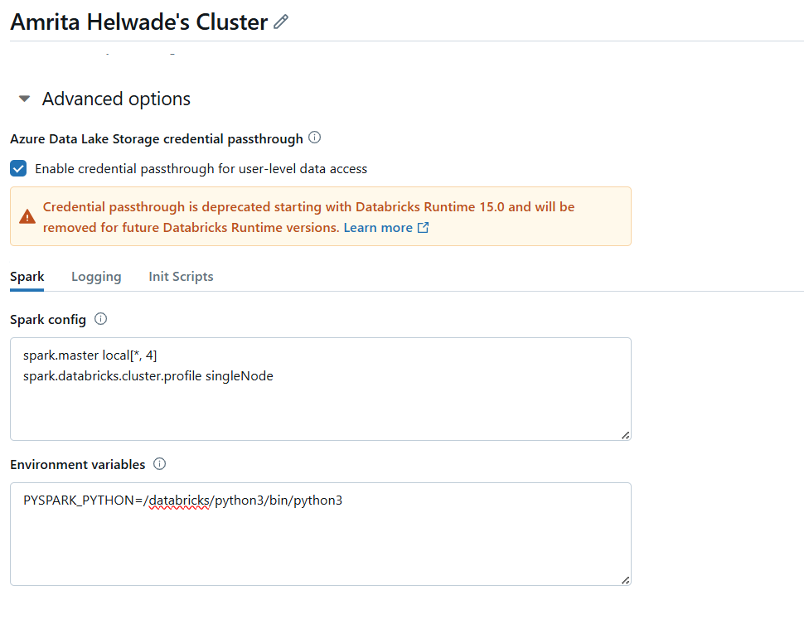
Practical
Click Enable credential passthrough for user-level data access
And restart the cluster.

Slide 61
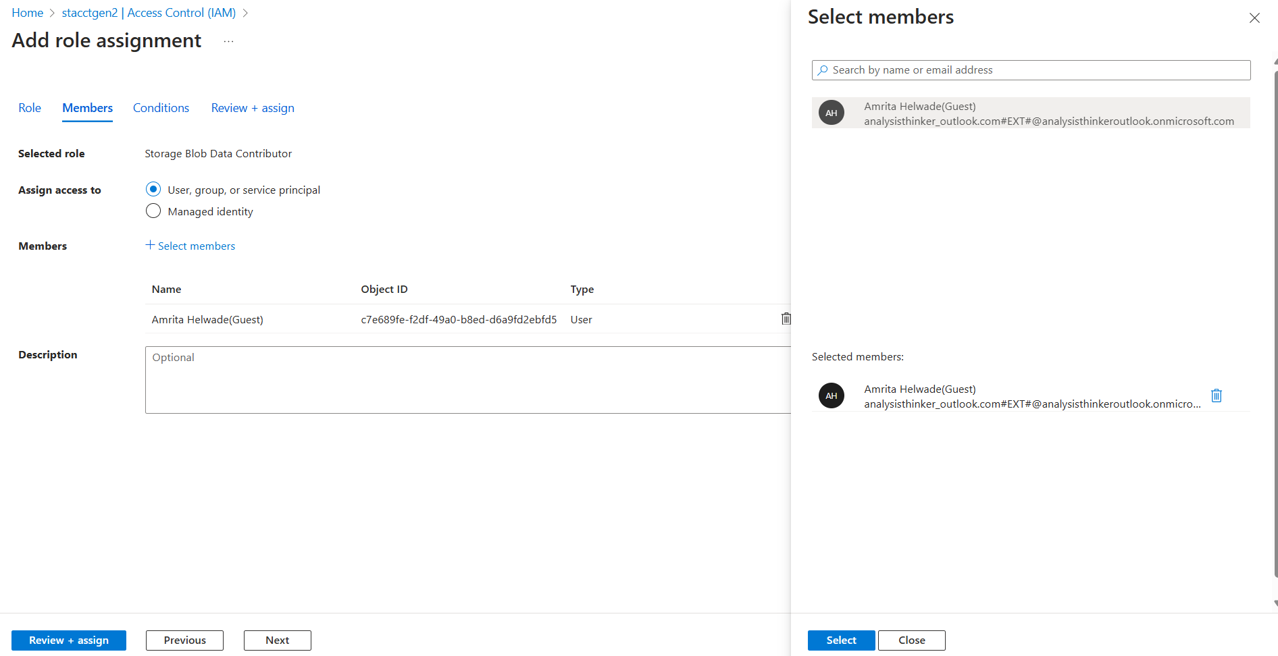

Slide 62
Thank You

